Slide 1


DataBase Logic in Business Applications
Al.I. Cuza University of Iași
Faculty of Economics and Business Administration
Department of Accounting, Information Systems
and Statistics
Oracle PL/SQL.
Procedures, Functions, Queries, Exceptions, Cursors
By Marin Fotache & Co.

Slide 2
Agenda
PL/SQL block general format (recap.)
General syntax and rules for procedures and functions
Recursivity (1)
Indirect variable declaration (%TYPE, %ROWTYPE)
Using queries (SELECT) in PL/SQL blocks
Error treatment (exceptions)
Implicit cursor
Explicit cursors

Slide 3
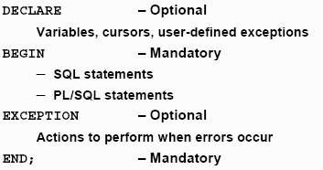
PL/SQL Blocks Format

Slide 4
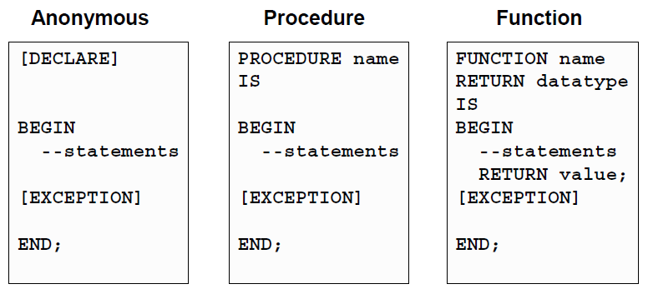
General Format of Anonymous Blocks, Procedures, and Functions

Slide 5
PL/SQL Procedures and Functions
Procedures DO some actions, processing
Functions return values or set of values
Both procedures and functions can be called (invoked) from:
Anonymous PL/SQL blocks
Other stand-alone procedures and functions
Procedures and functions within a package body
Triggers
External modules written in .NET, Java, PHP, etc.
Additionally, some functions can be used in SELECT queries. Cautions:
Their returned values must conform to the query result structure
Purity levels (some functions must not update the tables they query)

Slide 6
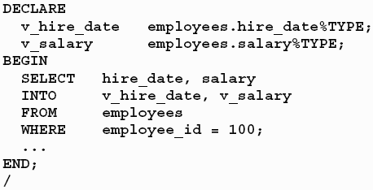
Queries within PL/SQL blocks. Indirect variable declaration
Indirect variable declaration

Slide 7
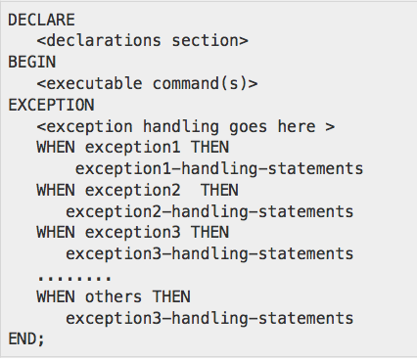
Exceptions
The name of the errors in PL/SQL
When error occurs, block execution jumps to the EXCEPTION section and then the block terminates
In order to treat the errors and resume the execution, blocks must be nested

Slide 8
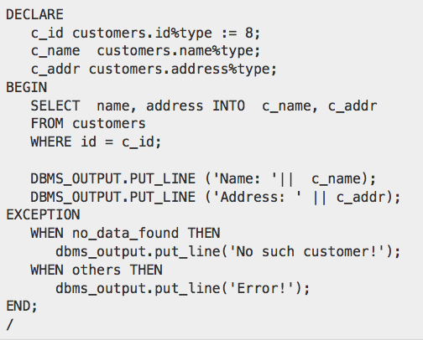
Exception Example (http://www.tutorialspoint.com)

Slide 9
Examples of Predefined Exceptions
NO_DATA_FOUND
TOO_MANY_ROWS
DUP_VAL_ON_INDEX
ROWTYPE_MISMATCH
PROGRAM_ERROR
CASE_NOT_FOUND
VALUE_ERROR
ZERO_DIVIDE
LOGIN_DENIED
NOT_LOGGED_ON

Slide 10
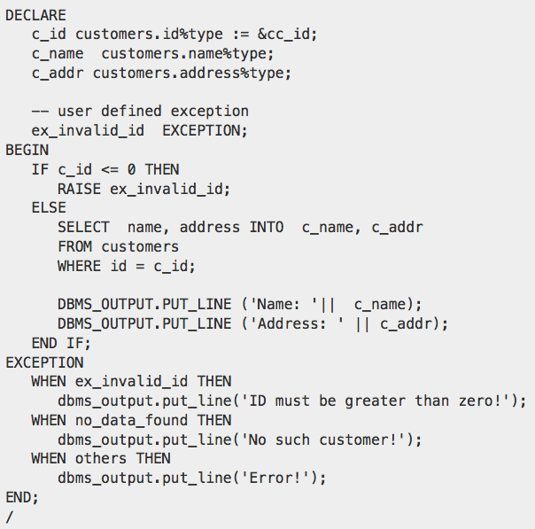
User-Defined Exception (http://www.tutorialspoint.com)

Slide 11
Recursivity (1)
CREATE OR REPLACE FUNCTION f_n_th_from_fibonacci
(n IN INTEGER) RETURN INTEGER
IS
BEGIN
IF n = 1 THEN
RETURN 0 ;
END IF ;
IF n = 2 THEN
RETURN 1 ;
END IF ;
RETURN f_n_th_from_fibonacci (n - 2) +
f_n_th_from_fibonacci ( n - 1 ) ;
END ;
/

Slide 12
Cursors
Vital ingredient in database application development
Common to all major database programming languages
Stardardized in SQL (since SQL:1999)
Implicit cursors provide information about the result of the most recent launched query
Explicit cursor are the main tool for tables records sequential processing
Used extensively by the database programmers

Slide 13
Implicit cursors
Automatically created by execution of a DML SQL statemeNt (INSERT...SELECT, UPDATE, DELETE)
Keep information about the most recent statement execution
BEGIN
UPDATE liniifact SET Linie = Linie + 1
WHERE NrFact=1111 AND Linie > 1 ;
DBMS_OUPUT.PUT_LINE (
'Au fost modificate' ||
SQL%ROWCOUNT || ' linii ') ;
END ;

Slide 14
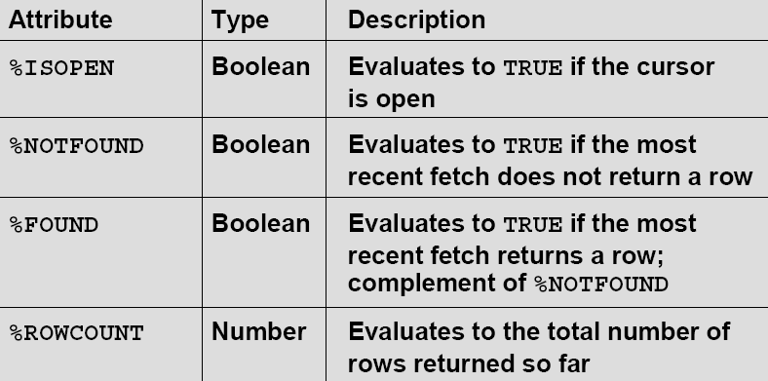
Implicit Cursor Attributes (Properties)

Slide 15
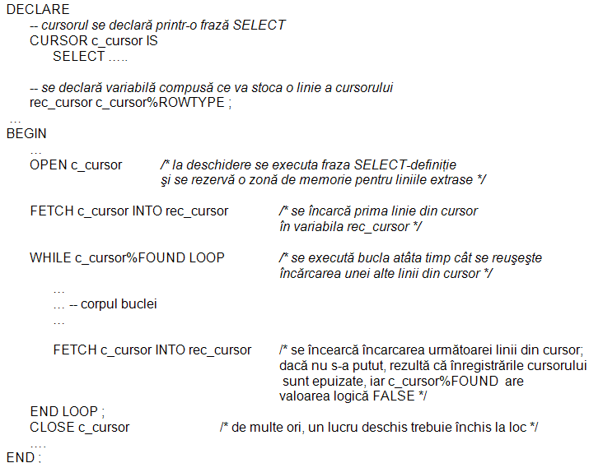
Explicit Cursors – Syntax 1

Slide 16
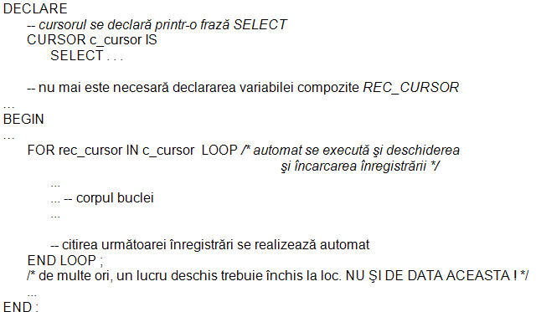
Explicit Cursors – Syntax 2

Slide 17
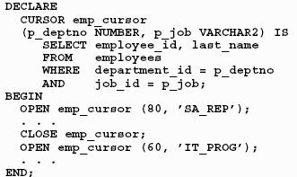
Parameterized Cursors

Slide 18
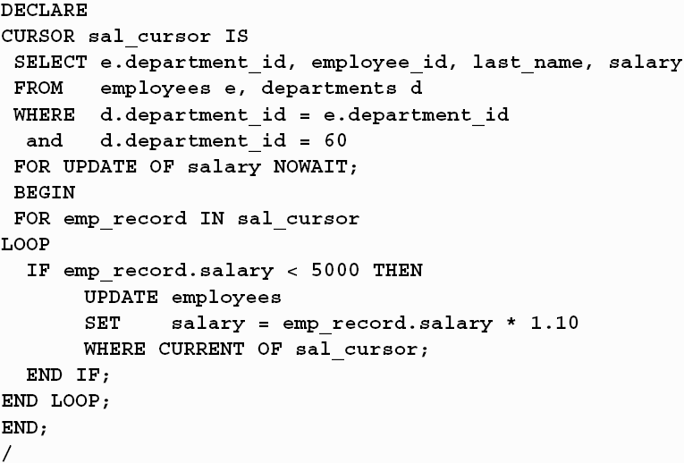
WHERE CURRENT OF Clause

Slide 19
Useful Resources
Getting started PL/SQL tutorial
http://www.way2tutorial.com/plsql/tutorial.php
PL/SQL Tutorial (TutorialsPoint)
http://www.tutorialspoint.com/plsql/index.htm
pl/sql tutorial
http://plsql-tutorial.com
PL/SQL Tutorial
http://www.plsqltutorial.com
Fotache et. 2003, Fotache 2009 (in Romanian) - uploaded on FEAA portal)
Steven Feuerstein - Working with Cursors, Oracle Magazine, March/April 2013,
http://www.oracle.com/technetwork/issue-archive/2012/12-jul/o42plsql-1653077.html
Steven Feuerstein - Working with Records, Oracle Magazine, May/June 2012,
http://www.oracle.com/technetwork/issue-archive/2012/12-may/o32plsql-1578019.html

Slide 20
Video-tutorials
An older video-tutorial (in Romanian): 04_Proceduri functii SELECT exceptii cursoare.mp4
https://1drv.ms/v/s!AgPvmBEDzTOSwlwA6IclMmi63jzq
PL21 PLSQL Tutorial Implicit Cursors
https://www.youtube.com/watch?v=sv7bEUs8rlw
PL22 PL SQL Tutorial Implicit Cursors Hands On)
https://www.youtube.com/watch?v=JNFmiQNbJRM
PL23 PLSQL Tutorial Explicit cursors in PL SQL blocks Theory)
https://www.youtube.com/watch?v=84104L3NnuY&spfreload=10
PL24 PL SQL Tutorial Explicit Cursors Hands on)
https://www.youtube.com/watch?v=ARuIyRd6qg4&spfreload=10
PL25 PLSQL Tutorial %TYPE and %ROWTYPE attributes
https://www.youtube.com/watch?v=vawx8CjftOo

Slide 21
Video-tutorials (cont.)
See also the following video-tutorials in the playlist:
https://www.youtube.com/playlist?list=PL3245012E0631F7AE&spfreload=10
PLS-21: PL/SQL Stored Procedure
PLS-22: Using Parameters in PL/SQL Procedure
PLS-23: PL/SQL Stored Functions
PLS-17: Predefined Exceptions in Oracle
PLS-18: Non Predefined Exceptions in PL/SQL
PLS-19: User Defined Exceptions in PL/SQL
PLS-9: Oracle PL/SQL Cursor
PLS-10: Oracle Pl/SQL Cursors With Parameters
PLS-11: Oracle PL/SQL Reference Cursor
PLS-13: PL/SQL Records Data Type

Slide 22
Text (in Romanian)
https://github.com/marinfotache/Database-Logic-in-Business-Applications/blob/master/Oracle%209i2.%20Ghidul%20dezvoltarii%20aplicatiilor%202003/Cap08_PL_SQL1/Oracle_Cap08_PL_SQL1.pdf (sections 8.1-8.5)
https://github.com/marinfotache/Database-Logic-in-Business-Applications/blob/master/Oracle%209i2.%20Ghidul%20dezvoltarii%20aplicatiilor%202003/Cap09_PL_SQL2/Oracle_Cap09_PL_SQL2.pdf (sections 9.1, 9.2)
https://github.com/marinfotache/Baze-de-date-I/blob/master/SQL.%20Dialecte%20DB2-%20Oracle-%20PostgreSQL%20si%20SQL%20Server/SQL2009_Cap16_Functii_si_proceduri_stocate.pdf (sections 16.1 (16.1.2), 16.2 (16.2.2), 16.3 (16.3.2), 16.5.2)

Slide 23
Git Hub Scripts Associated with this Presentation
https://github.com/marinfotache/Database-Logic-in-Business-Applications/tree/master/02_Basics%20of%20PL%20SQL
02_02a...
02_02b...
02_02c...
02_02d...
02_02e...
02_02f...
02_02g...
02_02h...

